Slide 1

Tableau

Slide 2
Data Analysis Can be boring
Searching for/obtaining data
Cleaning the data, you must make it “workable”
Analyzing & finding your answers
Trying to explain to people who don’t understand what you’ve found
YOU HAVE TO MAKE IT INTERESTING!
You WANT to be able to tell your STORY!

Slide 3
What is Tableau?
A very powerful data visualization software that helps people view and understand data.

Slide 4
It makes it easier for people to explore and manage their data.
It can be a central location for data from several sources
It will change raw data into data that is easy to understand
It is growing really fast as a key data analytics platform.
There’s a HUGE community of Tableau users
No coding necessary

Slide 5
Possible Job Titles
Business Analyst
BI Engineer
Data Analyst
BI Analyst
BI Developer
Verizon
Lenovo
Chipotle
REI
Charles Schwab

Slide 6
As a Data Analyst
You are required to manipulate the data in a tabular and systematic form to help solve some challenges that your company might be facing.
Business analytics, the importance of data visualization and how to utilize Tableau.

Slide 7
Business intelligence
The right information to the right people at the right time to aid in better decision making.
Business Analytics
Data mining
Data visualization
Data tools
Infrastructure

Slide 8
Examples
Identify ways to increase profit
Track performance
Analyze customer behavior
Compare data with competitors
Discover issues or problems
Optimize operations
Recognize trends
Predict range of successes

Slide 9

Data visualization
Uses pictures to represent data
Most effective way to communicate
LOTS of tools available
Allows for quantitative data to be viewed easier & better decisions made quickly

Slide 10



Slide 11
With tableau
Can utilize data in various forms (except for Tableau Public)
No technical or programming experience required
You can data blend (connect multiple sources for one analysis using joins)
Analyze in real-time
Collaborate with other team members

Slide 12
Advantages
Scripting language
Data Visualization
Quick Insights
Large amounts of data
Easy Implementation
Responsive Dashboard
Disadvantages
Restrictive Imports
Custom Formatting
Static Parameter
Screen Resolution
Scheduling Reports

Slide 13
Tableau Public
Can load from 9 different data sources
Tableau Desktop
Can load from 77 different data sources

Slide 14
Opening tableau public
Connect Pane: where various data sources can be connected
Open Pane: where you can see recently opened files/sample dashboards
Discover Pane: helps you connect with the Tableau Community and access videos and blogs.

Slide 15
Click on Microsoft excel open Sample – Superstore click/drag “orders” over to the white area on the right

Slide 16
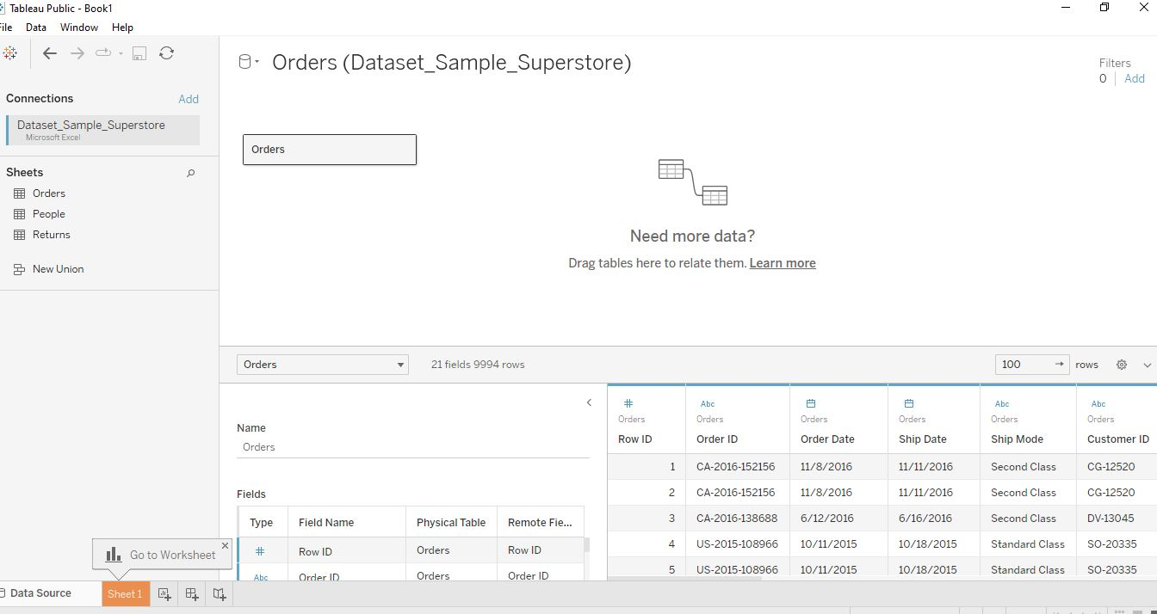

Slide 17
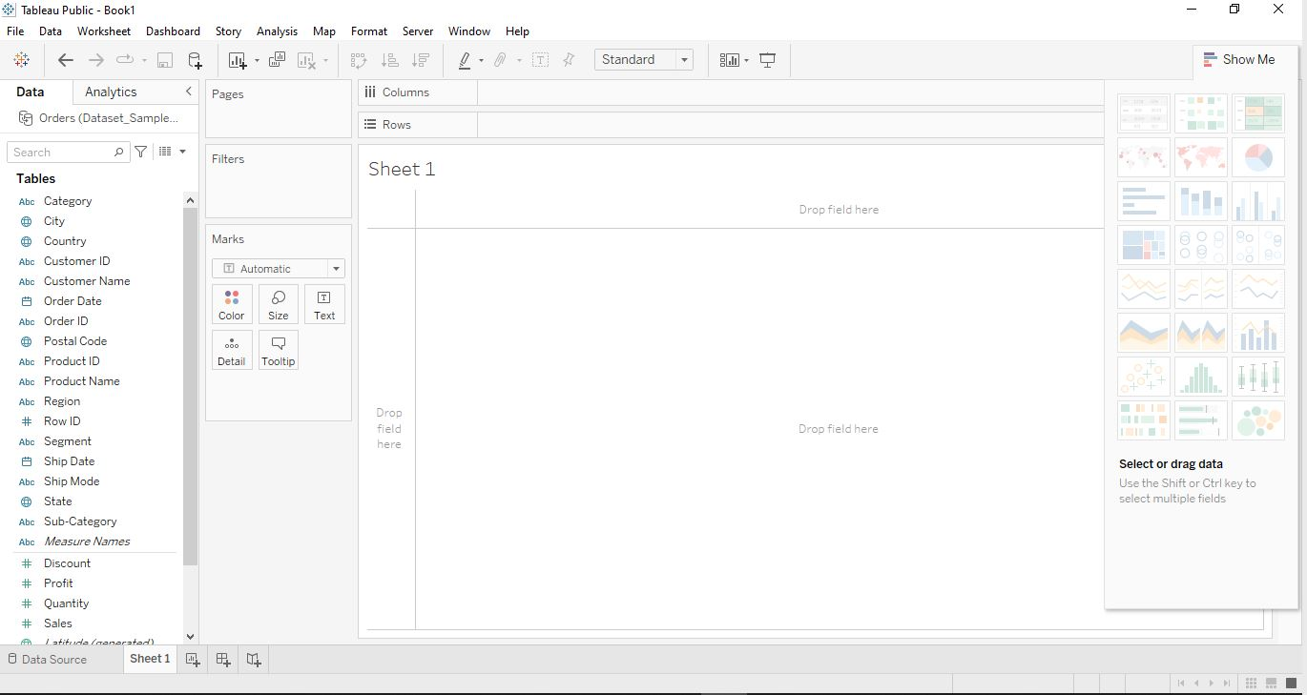
Quick Access Toolbar
D
A T A
P A N E

Slide 18
Tableau breakdown
Each graph should require a NEW worksheet & make sure they are named properly
Dashboards are preps for your STORY (aka presentation)
Think of each Dashboard as a “slide” where you put your STORY together. Make sure to name them properly
Your STORY is your presentation of how you want to show your Dashboards (aka slides)

Slide 19
Let’s practice
Plot SALES against CATEGORY, SEGMENT & ORDER DATE
Make it a line graph
Filter down to Home Office for each segment
Delete top title
Make it a bar graph
Rename it “Home Office Sales”

Slide 20
8 tools to prepare data for analysis
Joins
Relationships
Unions
Data Blending
5. Aggregations
6. Pivot
7. Data Interpreter
8. Split

Slide 21
joins
Combine data in order to filter and get rid of duplicates
Left Join
Right Join
Inner Join
Full Outer Join

Slide 22
Connect to the Sample-Superstore dataset
Move “Orders” over to the canvas
Right-click on “Orders” and click Open
Move “Returns” over to the canvas
This creates an inner join BY DEFAULT
Select the correct join

Slide 23
Tableau will identify the primary key for joining two or more data sets together
Left Join: values from LEFT Table & match to RIGHT Table
Right Join: values from RIGHT Table & match to LEFT Table
Inner Join: includes common data present in BOTH datasets
Full Outer Join: includes ALL values from both tables.

Slide 24
Relationships
Created when you drag more than one sheet over
Think of it as a contract between two tables
No joining
Automatic & context aware
Flexible

Slide 25
Joins versus relationships

Slide 26
unions
Helps bring together data from multiple small files into one large one.
Connect to dataset
Drag over needed sheet
Drag over another to overlap (you’ll see “union”)
Overlapping icon

Slide 27
Data blending
Tableau combines related data from multiple sources in a single view
Connect two sources (Superstore & Global Superstore)
Click on Data table & “Edit Blend Relationships”
Choose “Segment” and “OK”
Drag “Profit” from both sets over to Columns
Drag “Segment” from Global Superstore over to Rows

Slide 28
BLEND
Used to combine data from different databases that don’t support joins
Data w/in databases are at different levels of detail
Joins = duplicate rows
Involves large amount of data
JOIN
Data format is consistent across ALL sources
Involves small amounts of data
Data is at the same level of detail across sources

Slide 29
aggregations
Process of converting a set of values into a single value.
Done based on Measures & Dimensions
Aggregating Measures can be added to relational data sources
Aggregating Dimensions can be done by Minimum, Maximum, Count or Count(Distinct)

Slide 30
Let’s use the Sample Superstore Source
Drag “Sales” to Rows, Columns, or Text (inside Marks box)
Default is SUM
Right-click on SUM(Sales)
Choose Measure(SUM) & select desired aggregation from list (avg)
You can change the aggregation of any measure by clicking on a measure from the left-hand side, select Default Properties and Aggregation & select one

Slide 31
pivot
Select columns that need to be manipulated & formatting them into a typical dataset
Need to REMEMBER to pivot from Columns to Rows ( tall v. wide)
Data not formatted exactly in preview pane:
Select all columns in the file
Select pivot from pop-up menu

Slide 32
Data interpreter
Automatically cleans and prepares data
Available under Connections Pane whenever a unique format is detected.

Slide 33
split
String function used to split a column into multiple ones
Used to make data analysis easier
Offers both Automatic Split and Custom Split
Automatic: done by detecting a common separator
Custom: max of 10 new fields based on a separator in original field
Can split columns by clicking on column in preview pane and selecting
Example: Moving “City, State: Denver, CO” to two different cells

Slide 34
Data types inside tableau
Text Values
Date Values
Date and time Values
Numerical Values
Boolean Values
Geographic Values

Slide 35
Data roles
Dimensions v. Measures
Data is both textual & numerical, automatically segregated into either role
Dimensions: produce a header when added to row/column, categorical
Measures: produce an axes when added to row/column, numeric
Discrete v. Continuous
Every field is categorized as either discrete or continuous

Slide 36
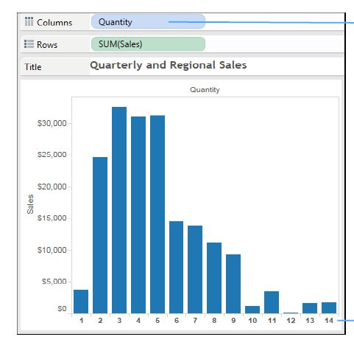
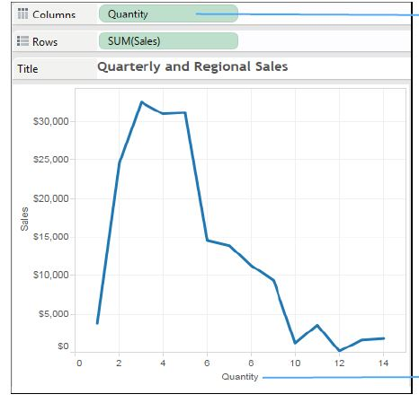
Discrete: every quantity as a header at the bottom
Continuous: quantity values are shown in a continuous axis

Slide 37
Working w/ metadata
Rename: sheet, column names
Hide: columns you don’t want to use
Unhide
Sort

Slide 38
Working with default fields
Adding a comment to a field
Changing a decimal number to a whole number
Right-click on field
Select Default Properties
Select Comment
You can view the comment when you put your cursor over the field
Right-click on field
Select Default Properties
Select Number Format
Select Number (Customer)
Set Decimal Place to Zero

Slide 39
Working with default fields
Change the Fiscal Year!
Changing a decimal number to a whole number
Right click on field
Select Default Properties
Select Fiscal Year Start
Select Month needed
Right-click on field
Select Default Properties
Select Number Format
Select Number (Customer)
Set Decimal Place to Zero

Slide 40
You can create aliases!
Right-click on any column and select Aliases
Update the alias name and click okay
Second Class would be where you would rename

Slide 41
You can filter your data

Slide 42
Dimension filter
General: selects one or multiple members from the domain
Wildcard: Matches values based on the presence of a string, the same starting and ending characters, or the same set of characters.
Condition: Matches values based on field or formula
Top: Highlights top values by field or formula

Slide 43
practice
Click on Entire View
Click on the sort option
Drag Sub-Category to Filters area
Create filter
You can remove filter by dragging Sub-Category outside of the filters area
Connect the SuperStore dataset
Drag “Orders” over to Canvas & go to Worksheet
Put SUM(Sales) in Columns
Put Sub-Category in Rows
Drag Sales to Label

Slide 44
Measure filter
Range of values: filter to identify sales representatives within a range of sales totals
At least: filter to identify sales reps with sales ABOVE a certain level
At most: filter to identify sales reps with sales BELOW a certain level
Special: filter to identify all values, null values and non-null values

Slide 45
practice
Drag Sales to filters
Click next
Set your filter
You can remove filter by dragging Sales outside of the filters area
Connect the SuperStore dataset
Drag “Orders” over to Canvas & go to Worksheet
Put Sub-Category in Rows
Put Sales in Text
Resize for visibility
Sort in descending order

Slide 46
Date filter
Relative Dates: can specify range of dates that is updated based on the date and time.
Range of Dates: can specify a range of dates to define a fixed range of dates to filter.
Discrete Dates: can specify a discrete date value in the dialog box
Individual Dates: can select individual dates to filter specific dates from the view
Additional date filter Options: can select null dates, non-null dates or all dates by specifying a start/end date.

Slide 47
practice
Restructure it by adding Year to Column
Drag Order Date to Filters
Click on Range of Dates
Click on Individual Dates
Connect Sample Superstore
Drag orders to canvas
Add Order Date to Rows
Add Sales to Text
Expand Order Date to Quarter and Month

Slide 48
Visual filter
Filters that are applied straight from Tables, Maps and Charts

Slide 49
practice
Connect Sample Superstore
Drag orders to canvas
Sub-Category > Rows
Sales > Columns & Text
Sort in descending order
Select Sub-Category & apply inclusion filter.

Slide 50
Context filter
The ONLY filter that is independent & used for:
Improving the performance of Tableau reports
Creating a dependent numerical filter
Any other filter defined alongside this one is a dependent one:
It’s dependent on the output of the context filter

Slide 51
practice
Add Sales to Label
Drag Category to Filters
Click on Furniture
Drag Sub-Category to Filters
Apply the filter
Connect Sample Superstore
Drag Orders to canvas
Drag Sub-Category to Rows
Drag Sales to Columns
Click on Entire View and sort in descending order

Slide 52
Data source filter
Applied to data sources that are connected to Tableau to make the worksheet work more efficiently.
The changes are done across ALL worksheets
Considered an efficient way to limit scope of data for performance/security purposes.

Slide 53
Extract filters are the same as data source filters, just applied to the extract connection.
Worksheet filters
Field Types
Dimensions (Region or product name)
Measures (Sales or profit)
Dates (Year or month)

Slide 54
practice
Click on Data Source & Add
Select add in the box
Click on City & OK & OK again
Can View entire worksheet filter in the top right corner.
Connect Sample Superstore
Drag orders to canvas
Add Regions to Rows
Add Sales to Text
Drag Region to Color
Sub-Category to Rows
Sales to Text & Columns

Slide 55
Interactive Filter
Allows users to interact with the data via Drop-down, List, Radio Button or Checkbox
Can be applied to: numbers, dates and strong

Slide 56
practice
Connect Sample Superstore
Drag orders to canvas
Drag Sub-Category to Rows
Sales to Columns & Label
Sort in Descending order
Select Sub-Category and click on show filter

Slide 57
Let’s do some sorting
Based on data course order, field, ABC order or manual
On a measure, can be applied through a dimensional sort

Slide 58
groups
Aggregate the data of dimension members
Example: top 5 sales reps by total salary are in a single row
Once grouped, can be used inside of any filters

Slide 59
sets
Custom fields that define a subset of data based on some conditions
Example: customers with sales over a certain level
CONSTANT sets: do not change after they are created
COMPUTED sets: types of sets that change with the change in data
COMBINED sets: two sets combined to compare different members
BUILDING sets: created through manual selection, condition, ranking

Slide 60
bins
Equal-sized containers that store data values that correspond to or fit within the bin size.
Can use any discrete field to create them
Right click on field, select Create and then Bins
Create new field name & designate size
Press OK

Slide 61
Hierarchies
An arrangement where entities are present at various levels
Created by adding one dimension as a level under the principal one
Example: Category & Sub-Category in Rows and SUM(Sales) in Text
Can be used as dimensions
Right-click, click Hierarchy > Create Hierarchy > Add Hierarchy
> Add dimensions

Slide 62
Creating charts
Easier to understand then tables with numbers
Click on “Show Me” button on upper right corner
Working with Sample-Superstore dataset
Orders sheet on Canvas

Slide 63
Text table & cross table
Drag Sub-Category to Rows
Drag Region to Columns
Drag Sales to Text under Marks

Slide 64
Highlight tables
Region > Columns
Sub-Category > Rows
SUM(Sales) > Text
Change drop-down to Square
Sales > Colors in Marks Card
Edit Colors > Select color palette

Slide 65
Heat maps
2-D representation of data that uses colors to convey info
As the density of records per mark increases, the color intensity increases.
Sub-Category > Rows & Region > Columns
Marks > Square
SUM(Sales) on Color in Marks Card and edit it

Slide 66
Stacked bar chart
Used to highlight one measure against several other values
Each category is divided into subcategories for detailed analysis
Can split bar into categories
Sub-category > Columns & SUM(Sales) > Rows
Region > Color under Marks Card

Slide 67
Line chart
Shows trend of data over a period of time
Normally used when there’s a date data type
Order Date > Columns
Sales > Rows (Marks type should change automatically to line)
Date can be discrete or continuous (Right-click on Order Date)

Slide 68
sparkline
Densely populated line chart that help in understanding anomalies
“Anomalies” in the data are noticed when the number of data points increases in a line chart.
Order Date > Columns, click on it and select Day
Sales > Rows

Slide 69
Scatter plot
Used to show the correlation between two measures
Create magic quadrants and identify the relationships between measures.
Both axeses will have numerical fields
Other fields can be added via color, size or shape
Sales > Columns & Profit > Rows
Sub-Category > Detail
Adjust colors and shapes

Slide 70
Tree map
Displays hierarchical items in rectangular boxes consisting of a large rectangle divided up into smaller ones to represent sub-categories.
Region > color & Select Mark Type as square
Sales > Size & State > Detail &Text

Slide 71
Bubble chart
The size of the circles denotes the quantity of the metric.
Region > Color & Select circle for mark type
Sales > Size
State > Detail & Text

Slide 72
Word cloud
Displays frequency of words in a text by making the size of each word proportional to its frequency.
They can have meta-data associated with them.
Region > Color & Mark as Text
Sales > Size
State > Detail & Text

Slide 73
Combined axis chart
Use multiple mark types in the same sheet!
Order Date > Columns & select month in date value
Sales > rows
Profit on top of Sales Axis ON CHART until two scale symbol appears

Slide 74
Dual axis chart
Consists of two independent axes that are on top of each other
Illustrates relationship between the two variables
Used to compare multiple measures of the same category.
Types of charts:
Bar vs. line
Bar in bar
Bar vs. circle
Lollipop

Slide 75
Order date > columns (set by Date Value months)
Sales > Rows
Profit next to Sales in Rows
Right-click on Profit axis & select Dual Axis
Change axis range of Profit, right-click on profit and select Synchronize axis
Change type of Mark for Sales to bar

Slide 76
Funnel chart
Normally used in marketing and sales
Helps present sales, profit, and revenue at different stages
Created for single measure value and multiple measure value
Sales > Rows & select affregate type as SUM
Region > Color
SUM(Sales) > Size & put in descending order
Convert Standard View to Entire View
Add Region & SUM(Sales) to Label box

Slide 77
Let’s talk about maps

Slide 78
maps
Provide more context for the dashboard making it easier for users to spot trends in the data.
There are Symbol Maps and Filled Maps
State > Details (notice long. And Lat come up automatically)
Change Marks to Map
Profit > Color

Slide 79
Panning, zooming & selecting
Top left corner of a map, there’s a toolbar and search box
The toolbar selects marks on the map, pans & zooms in/out
To zoom in, select zoom area option and drag to wanted area
Zooming creates fixed ranges, click the Pushpin to reset.
Holding SHIFT, you can drag to move around the map
Dashed outline tools can be used to select specific areas on map

Slide 80
Using maps to filter
Can create actions on a map that filter data on a map

Slide 81
Map layering
Change the appearance of your map by clicking on MAP at the top and choosing “Map Layers”
You can change the background style
Hide/Show map layers like land borders, etc.
ADD data layers

Slide 82
Creating custom territories
A group is created based on the selection of custom territories either manually or by a calculated field.

Slide 83
Modifying locations
Tableau might fail to recognize the location names so you can go in and set them manually.

Slide 84
geocoding
Process of converting text-based description of a location into coordinates.
Using an external CSV is possible incase Tableau can’t identify the geographical field automatically.

Slide 85
Adding a background image makes the dashboard more appealing

Slide 86
Map search
You can search for a specific location on your map
Postal Code, Continent, City, Country and State/Province
Located in upper left corner

Slide 87
Calculations in tableau

Slide 88
Basic expressions
Simple calculated fields created using the “Create Calculated Field” option
Can be either a dimension or a measure
Can be created either at a row or aggregated level
Aggregated level calculations use all fields to create the aggregated field.

Slide 89
Level of details
Powerful functions that alter the level of detail
Choices can be made between aggregation and granularity
Three different expressions: include(), exclude() and fixed ()
Include increases aggregation, exclude increases granularity and fixed increases independence.

Slide 90
Fixed level of detail example
FIXED level of detail expressions compute a value using the specified dimensions, without reference to the dimensions in the view
We are going to create a chart that shows the interval between a customer’s first purchase date and any subsequent purchase

Slide 91
Open Tableau, connect to Sample Superstore and pull over Orders to canvas, create a new worksheet
Click on Analysis and go to Create Calculated Field
Create 2 calculated fields: a FIXED level of detail expression and a date subtraction
FIRST PURCHASE DATE: {FIXED [Customer Name] : MIN([Order Date])}
DAYS SINCE FIRST PURCHASE: DATETRUNC(‘day’,[Order Date])-DATETRUNC(‘day’, [FIRST PURCHASE DATE])

Slide 92
Drag Days Since First Purchase from Measures to Dimensions (it’s automatically a Measure because it contains a number)
Drag Days Since First Purchase to Columns, click on it and choose Continuous
Drag Sales to Rows and change aggregate to AVG
Click on Sales and Choose a Running Total Quick Calculation
Drag First Purchase Date to Color
Click on it in Color field and change it to Quarter
Click on the dots next to the Quarter field and click colors

Slide 93
It’s interactive! Click on the different years in the legend

Slide 94
Include level of detail example
Compute values using the specified dimensions in addition to whatever dimensions are in the view.
Useful when you want to calculate at a fine level of detail in the database and then re-aggregate and show at a coarser level of detail in your view. Fields based on INCLUDE level of detail expressions will change as you add or remove dimensions from the view.
Create a visual of total sales per customer per region

Slide 95
Click on Analysis and Select Create Calculated Field
Name is SalesPerCustomer
{INCLUDE [Customer Name] : SUM([Sales]) }
Place SalesPerCustomer on ROWS and aggregate it as an AVG
Put Region in Columns shelf

Slide 96
NOW
Drag SALES over to Rows
Shows the difference between the sum of sales (somewhere between $390k and 700k per region) AND the avg sales per customer (between 750 and 1100 per region)

Slide 97
Exclude level of detail example
prevent the calculation from using one or more of the dimensions present in the view.
useful for ‘percent of total’ or ‘difference from overall average’ scenarios. They are comparable to such features as Totals and Reference Lines.
cannot be used in row-level expressions (where there are no dimensions to omit), but can be used to modify either a view level calculation or anything in between (that is, you can use an EXCLUDE calculation to remove dimension from some other level of detail expression).

Slide 98
Go to Analysis and Select “Create Calculated Field”
Name is ExcludeRegion
{EXCLUDE [Region] : SUM([Sales])}
Move Region and Sales to Columns
Order Date to Rows and make sure it’s by MONTH
This breaks out the sum of sales by region and month
Drag ExcludeRegion over to Color
Shades the view to show total sales by month w/o regional component

Slide 99
Table calculations
Allow transforming values at the detail level of visualization only.
Executed based on a tabular format with fields in rows and columns.
Ad-hoc calculations
Temporary calculations that are carried out only for current visualizations.

Slide 100
Key performance indicator table
Sub-Category to Rows, Region to Columns and Sales to Text
Create a Calculated Field “KPI”
IF SUM ([SALES]) > 25000 THEN “ABOVE BENCHMARK” ELSE “BELOW BENCHMARK” END
Change Mark card to Shape from drop down
KPI > Shape
Click Shape and choose KPI: Above (green) and Below(red)
Change Sums from Text to Detail

Slide 101
extras
Tooltips display when you put the mouse over one or more marks in view
Utilize the Analytics tab for Modeling & Summarizing
Use trend lines in predicting of given data (linear, logarithmic, exponential and polynomial)
Forecasting depends on the number of historical data points available
Clustering groups data points together and separating them from other dissimilar data objects

Slide 102
Your dashboard

Slide 103
The interface
Default = the device that the dashboard will be created
Size = size of your presentation screen
Sheets = shows the names of your Worksheets
Objects = how to place sheets and add other helpful items

Slide 104
Objects on your dashboard
Horizontal/Vertical: how to display your sheets and other objects
Text: creates a text box
Image: insert outside images (like a pic of a matplotlib plot!)
Webpage: creates a web page interface
Blank: creates blank box
Navigation: provides users with ability to build navigation buttons
Download: dashboard can be downloaded in PDF format
Extensions: third-party allowing customized visualizations
Ask Data: AI functionality from Tableau Server

Slide 105
Click and drag sheets over to the canvas to use
Tiled: Fixed Location & Floating: unfixed location
You can highlight data & add URL links

Slide 106
Best practices
Choose appropriate visualizations
Line charts: best for seeing change over time
Maps: best for seeing geographical data
Bar Charts: best for seeing highest or lowest value
It is difficult to read long names vertically
Choose appropriate size: avoid scroll bars & scrunched views

Slide 107
Your storyboard

Slide 108
Groups of dashboards and visuals arranged to tell your story
They are dynamic and interactive!
Left side has created dashboards, text option and size
Layout tab has Navigator styles
The grey boxes designate slides & provide area for you to make notes
Drag visualizations and dashboards as appropriate
Your work gets saved automatically to Tableau Public

